Slide 1
Destinations Ratings
Based on feedback scores, average hotel star rating, number of all-inclusive hotels, most visited city.

Slide 2
15 SELECTED DESTINATIONS

Slide 3
Lowest Scoring Destination: St Lucis has the lowest score of visited countries in this list, the average star rating of hotels in St Lucia is 6, 6 inclusive hotels in the destination and Canaries is the most visited city in St Lucia.
Destinations | Feedback_10 | Star_rating | Inclusive_hotels | Most_visited
St_Lucia | 2.0 | 2.0 | 6 | Canaries

Slide 4
Highest scoring destination
Destinations | Feedback_10 | Star_rating | Inclusive_hotels | Most_visited
UAE | 9.0 | 5.0 | 7 | Dubai

Slide 5
Destinations where there are more than 9 all-inclusive hotels.
Destinations | Feedback_10 | Star_rating | Inclusive_hotels | Most_visited
0 | Greece | 8.0 | 4.0 | 10 | Thens
1 | Turkey | 7.0 | 3.0 | 11 | Izmir
2 | Denmark | 6.0 | 3.0 | 21 | Aarhus
4 | Dominican_Rep | 5.5 | 3.0 | 12 | Barahona
5 | Thailand | 5.0 | 4.0 | 13 | Bankok

Slide 6
Destination with a score above 8
Destinations | Feedback_10 | Star_rating | Inclusive_hotels | Most_visited
14 | UAE | 9.0 | 5.0 | 7 | Dubai

Slide 7
10 Destination with highest feedback scores
Destinations | Feedback_10 | Star_rating | Inclusive_hotels | Most_visited
14 | UAE | 9.0 | 5.0 | 7 | Dubai
0 | Greece | 8.0 | 4.0 | 10 | Thens
1 | Turkey | 7.0 | 3.0 | 11 | Izmir
3 | Italy | 7.0 | 3.5 | 9 | Rome
2 | Denmark | 6.0 | 3.0 | 21 | Aarhus
13 | Seychelles | 6.0 | 3.0 | 4 | Victoria
4 | Dominican_Rep | 5.5 | 3.0 | 12 | Barahona
5 | Thailand | 5.0 | 4.0 | 13 | Bankok
7 | Maldives | 5.0 | 3.0 | 8 | Male
8 | Barbados | 5.0 | 2.0 | 15 | Bridgetown

Slide 8
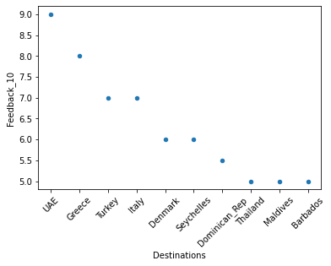
Scatter plot of 10 highest destinations and scores
<AxesSubplot:xlabel='Destinations', ylabel='Feedback_10'>

Slide 9
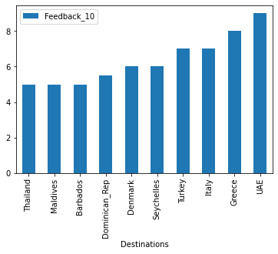
Bar chart of 10 highest destinations and scores
<AxesSubplot:xlabel='Destinations'>

